Slide 1
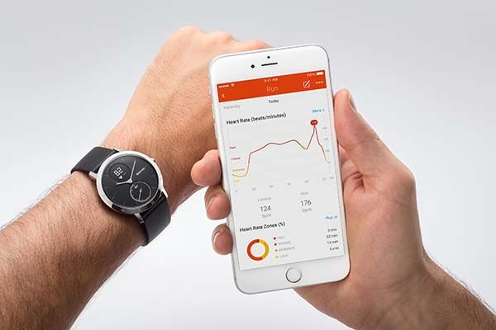

Smartwatch ECG Monitoring in Healthcare
Enhancing Heart Health Through Digital Technology
By: Cassandra Foster
October 7, 2025
ThePhoto by PhotoAuthor is licensed under CCYYSA.

Slide 2
Intro & Background
Personal experience: mild stroke in 2021 due to high blood pressure
Early exposure to BP monitoring with my mother
Evolution: stationary devices → portable monitors → smartwatches with ECG
Apple Watch enabled continuous heart tracking and easy data sharing with my doctor
Other devices exist, but many users are unaware of ECG features
Wearables are transforming preventive heart care

Slide 3
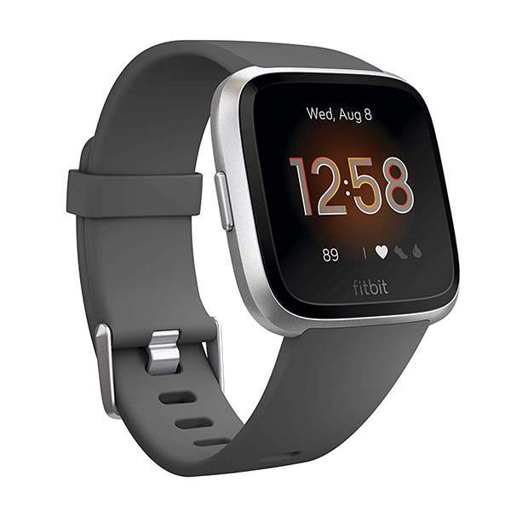
Technology Evaluation
Real-time ECG monitoring
Early detection of arrhythmias (AF)
Integration with EHRs and mobile apps
ThePhoto by PhotoAuthor is licensed under CCYYSA.

Slide 4

Technology Evaluation – Pros and Cons
Pros
  Continuous monitoring
  Patient empowerment
  Data sharing with clinicians
Cons
  Accuracy vs. hospital-grade ECGs
  False positives
  Workflow challenges
ThePhoto by PhotoAuthor is licensed under CCYYSA.

Slide 5

Ethical Implications
Privacy & data security
Access and equity
Informed consent
ThePhoto by PhotoAuthor is licensed under CCYYSA.

Slide 6

Patient Outcomes
Early AF detection (Apple Heart Study, mSToPS trial)
Improved engagement, safety, and quality of life
KPIs: detection rate, hospital visits, patient satisfaction
ThePhoto by PhotoAuthor is licensed under CCYYSA.

Slide 7

Software Development Life cycle (Part 1)
Planning: feasibility, stakeholders, objectives
Requirements Analysis: accuracy, security, usability, interoperability
Design: Data flow: Watch → App → Cloud → EHR
ThePhoto by PhotoAuthor is licensed under CCYYSA.

Slide 8
SDLC (Part 2)
Implementation: resource allocation (bar chart suggested)
Testing: usability, functionality, interoperability (pie chart/dashboard suggested)
Deployment: phased vs. big bang (comparison chart suggested)
Maintenance: updates, troubleshooting, audits (cycle diagram suggested)
Procurement: vendor selection, cost control, standards compliance

Slide 9

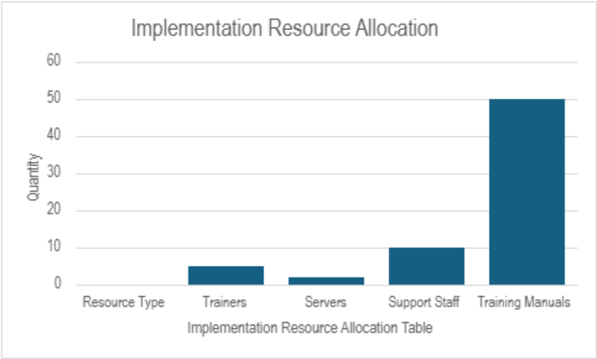
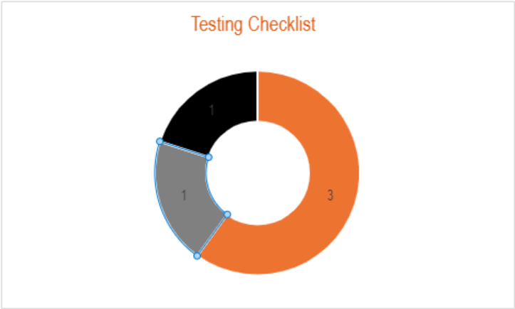
SDLC Visuals
ThePhoto by PhotoAuthor is licensed under CCYYSA.

Slide 10
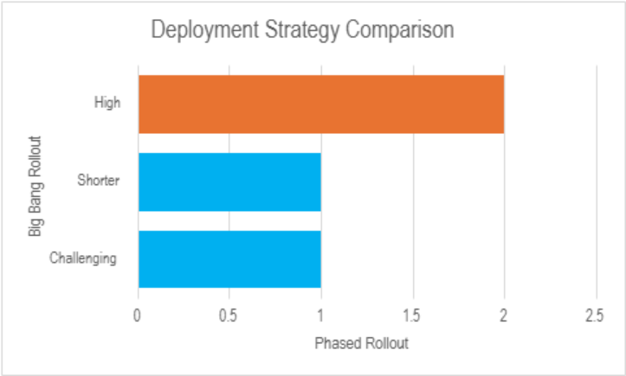
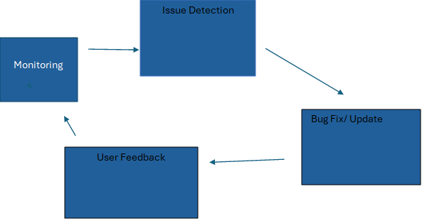
SDLC Visuals (continued)

Slide 11

System Configuration Plan
User dashboards: clinicians, wellness coordinators, researchers
Alerts and on-demand ECG recordings
Optional modules: fitness, stress tracking

Slide 12
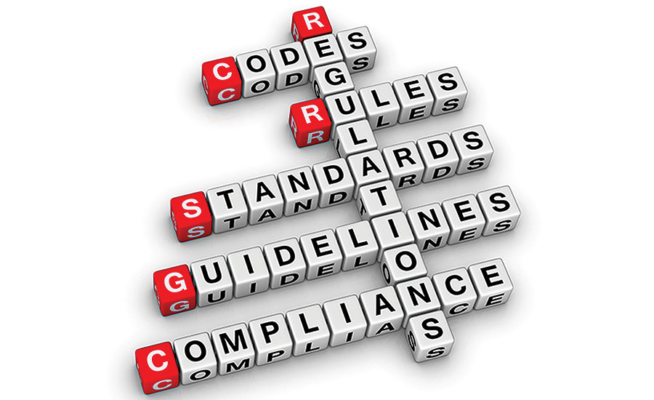
Standards & Compliance
HL7, FHIR, ISO/IEEE 11073 for interoperability
HIPAA and GDPR for privacy
ThePhoto by PhotoAuthor is licensed under CCYYSA.

Slide 13

Integration & Security
Data flow into EHRs/EMRs
Role-based access, encryption, secure logins
Consent management for wellness programs

Slide 14
Patient Outcomes Visualization
Early AF detection (Apple Heart Study, mSToPS trial)
Improved engagement, safety, and quality of life
KPIs: detection rate, hospital visits, patient satisfaction

Slide 15

Conclusion & Recommendations
Invest in secure integration and staff education
Use phased implementation
Expand access through collaborations or wellness programs
Continuously monitor outcomes via KPIs

